Slide 1
SQL PROJECT ON PIZZA SALES

Slide 2
HELLO !
My name is Smriti Rao. In this project I have
utilized SQL queries to solve questions that
were related to pizza sales.

Slide 3
QUESTIONS
Basic:
Retrieve the total number of orders placed.
Calculate the total revenue generated from pizza sales.
Identify the highest-priced pizza.
Identify the most common pizza size ordered.
List the top 5 most ordered pizza types along with their quantities.
Intermediate:
Join the necessary tables to find the total quantity of each pizza category ordered.
Determine the distribution of orders by hour of the day.
Join relevant tables to find the category-wise distribution of pizzas.
Group the orders by date and calculate the average number of pizzas ordered per day.
Determine the top 3 most ordered pizza types based on revenue.
Advanced:
Calculate the percentage contribution of each pizza type to total revenue.
Analyze the cumulative revenue generated over time.
Determine the top 3 most ordered pizza types based on revenue for each pizza category.

Slide 4
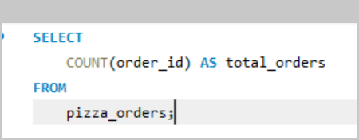

Retrieve the total number of orders placed

Slide 5
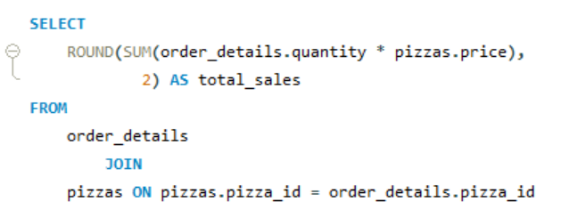
Calculate the total revenue generated from pizza sales.

Slide 6
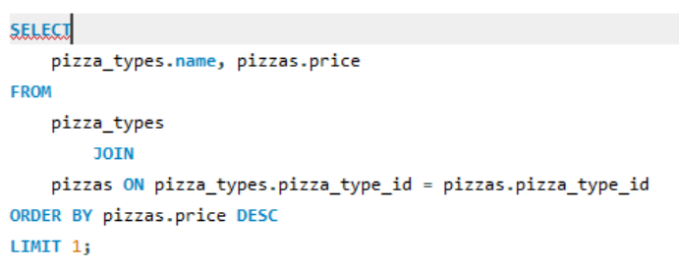
Identify the highest-priced pizza.

Slide 7
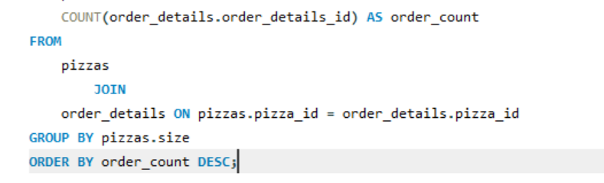
Identify the most common pizza size ordered

Slide 8
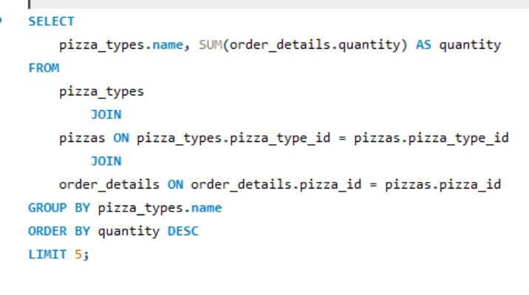
List the top 5 most ordered pizza types along with their quantities.

Slide 9
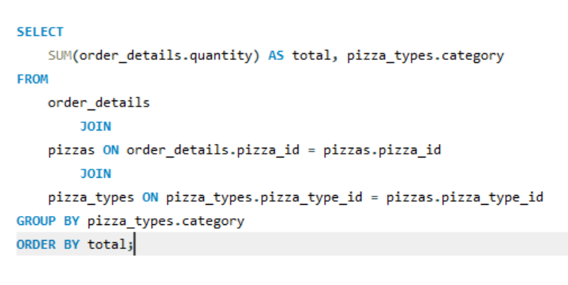
Join the necessary tables to find the total quantity of each pizza category ordered

Slide 10
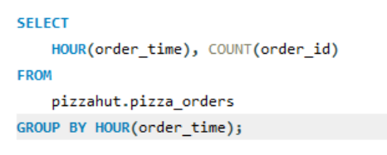
Determine the distribution of orders by hour of the day.

Slide 11
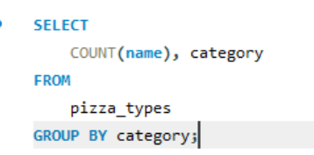
Join relevant tables to find the category-wise distribution of pizzas

Slide 12
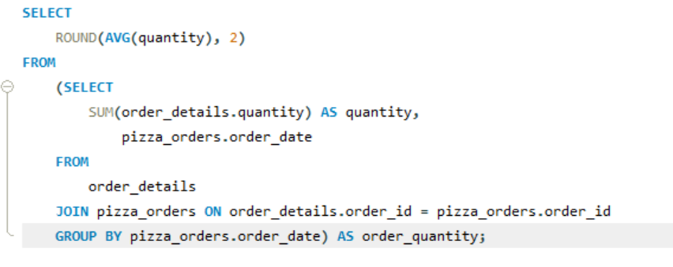
Group the orders by date and calculate the average number of pizzas ordered per day.

Slide 13
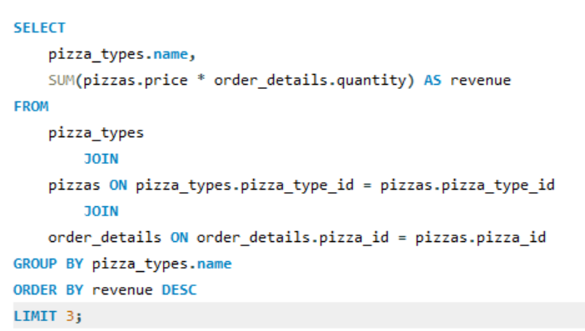
Determine the top 3 most ordered pizza types based on revenue

Slide 14
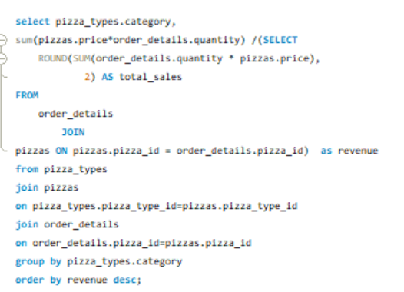
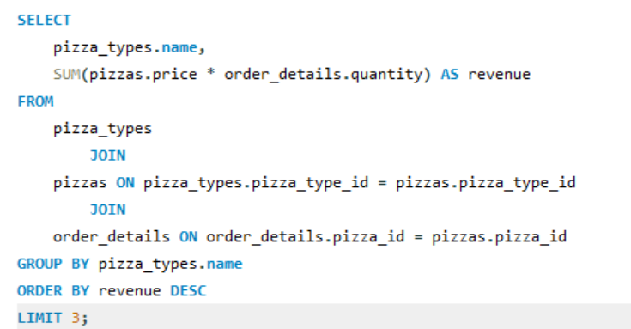
Calculate the percentage contribution of each pizza type to total revenue.

Slide 15
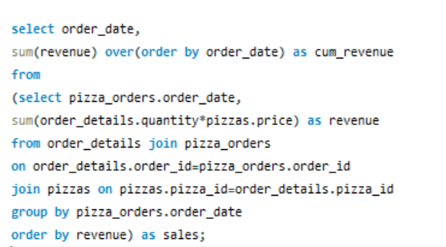
Analyze the cumulative revenue generated over time

Slide 16
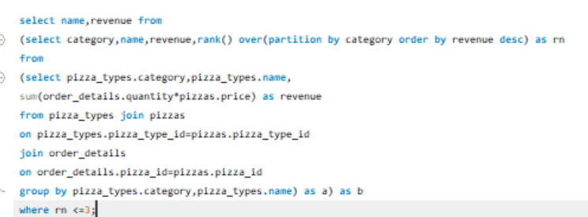
Determine the top 3 most ordered pizza types based on revenue for each pizza category

Slide 17
THANK YOU

